Slide 1

Case study: NLP in practice
Dinghan Shen
June 19, 2019

Slide 2
(A tiny sample of) NLP applications
Notes:
Newspaper industry, brief or summary of an article, saves editors’ time.
More than 100 languages, directly translate words from a photo.
Some of the most well-known products are Alexa, Siri, Google Assistant.
Book air tickets & hotels. Use it to interact with the world while driving.
Transit to emails

Slide 3
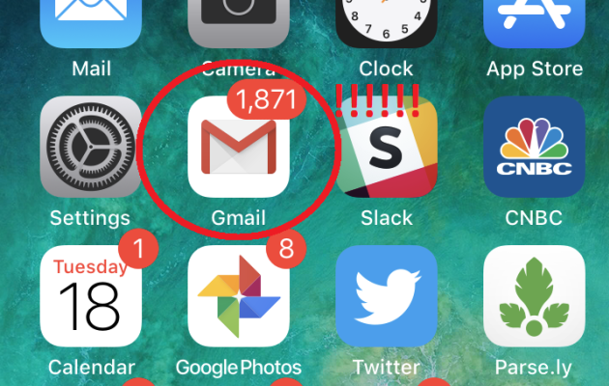
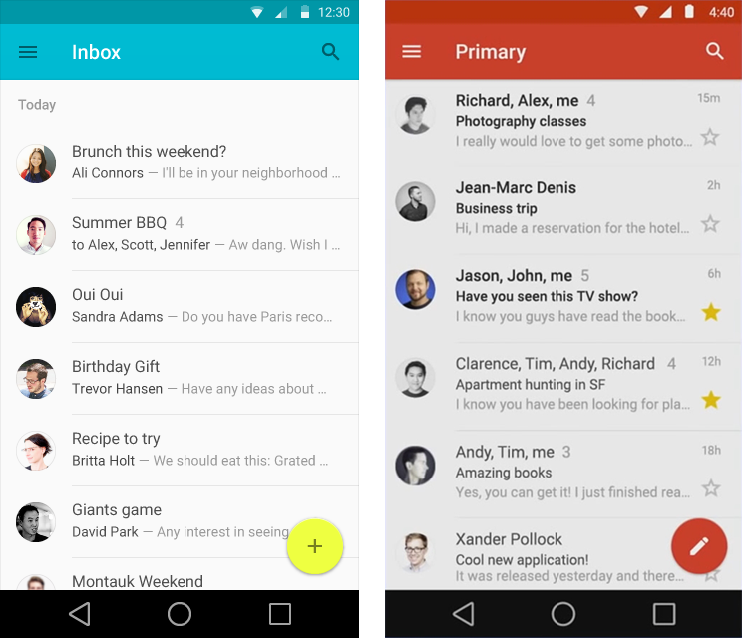
Notes:
Wake up in the morning, see tons of unread emails
You open the Gmail app, you are thinking probably it is a good idea to reply them on the go
Say you are on a subway, you are waiting for your next class, you are in a boring meeting, those are great time to reply those emails.
But here comes the pain point.
Here's where NLP comes in. The motivation of this product is to assist users writing email replies on their mobile devices. So how do we do that? Let's take a look at a short demo.

Slide 4
Smart Reply
Three replies are recommended to users
The replies are inferred according to the email contexts
Greatly facilitate replying email on the go
Notes:
This feature is called smart reply, you can get access to this function no matter you are using gmail on your cell phone, or laptops, desktops.
Automatically recommend,
It should be stressed that these replied are inferred ...
The system will tailor those replies
With those replies, you can either directly use it and send it out. Or, you can also edit based on it.
“Have you had a chance to look over the most recent data logs? The team is very interested to see how it landed in the market”
“Yes, I am working on it” “Working on it now” “No, I have not.”

Slide 5
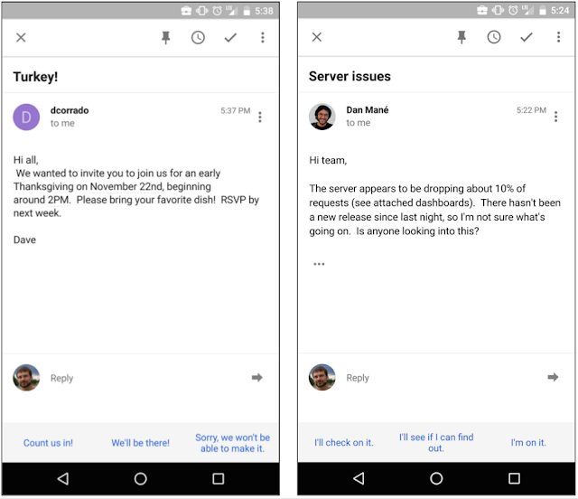
Since its initial release, Smart Reply feature makes up about 12% of replies in Inbox on mobile!
Notes:
In this lecture, we want to give you a sense about how this feature has been carried out. How NLP has played an important role in achieving this functionality.

Slide 6
Underlying Challenges
Universally accessible to billions of users
The privacy of user data
Fast computation and memory-efficient

Slide 7
Outline
Model design
Incorporating hierarchical structures
Engineering challenges
Safe but too generic replies
Replies with repetitive patterns
On-Device Deployment
Extended to other application scenarios

Slide 8
Outline
Model design
Incorporating hierarchical structures
Engineering challenges
Safe but too generic replies
Replies with repetitive patterns
On-Device Deployment
Extended to other application scenarios

Slide 9
Model Choice
Email Context => Replies
Rule-based system | Machine-learned system
Hand-crafted by humans, Time-consuming, Quickly outstripped by the diversity of human language, Hard to adapt for new language usages. | Automatically learned from data, implicitly captures diverse situations, writing styles, and tones, Can digest new data in a dynamic manner.

Slide 10
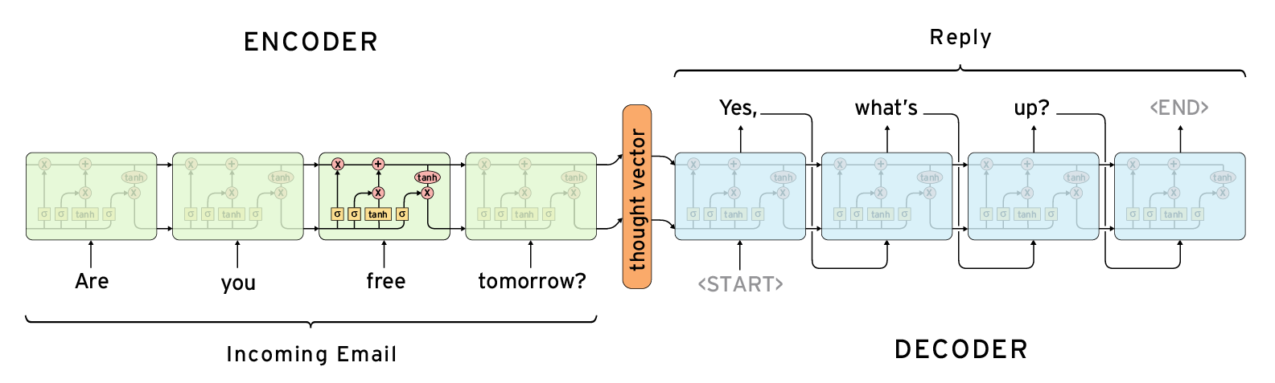
Sequence-to-sequence Architecture
Recurrent Neural Networks

Slide 11
Sequence-to-sequence Architecture
Long short-term-memory
Gating mechanism: gathering critical information

Slide 12
Sequence-to-sequence Architecture
Thought vectors: captures the gist (semantic meaning) of what is being said.
Example: “Are you free tomorrow?” should be close to “Does tomorrow work for you?”
Notes:
So that for similar incoming emails, similar replies will be recommended to the users.
Fast computation: latency issues, the model takes a long time to product the word one by one.

Slide 13
Casted as a Sequence Matching problem
Dot Product
Training data: positive and negative pairs.
Incoming email is transformed into a dense (real-valued) vector with the LSTM encoder networks
The embeddings of every potential reply is compared with the email embedding
The top-3 replies are selected
Embeddings
Embeddings
LSTM Networks
Incoming email
Reply

Slide 14
Outline
Model design
Incorporating hierarchical structures
Engineering challenges
Safe but too generic replies
Replies with repetitive patterns
On-Device Deployment
Extended to other application scenarios

Slide 15
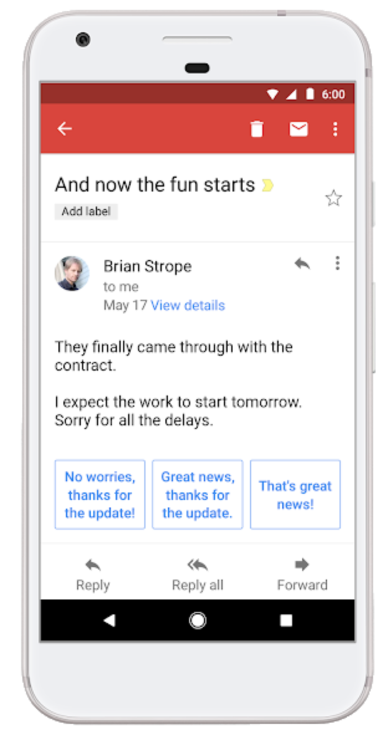
Incorporating hierarchical structures
Natural language is inherently hierarchical:
letters => words => phrases => sentences => paragraphs => sections => chapters => books => authors => libraries
Title
Body
A hierarchical approach to learning is well suited to the hierarchical nature of language
History

Slide 16
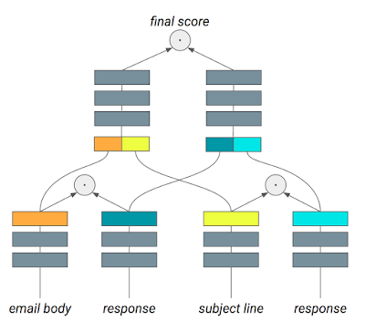
Extracting features that correspond to sequences at different temporal scales
Document-level
Sentence/paragraph-level
Word-level

Slide 17
Outline
Model design
Incorporating hierarchical structures
Engineering challenges
Safe but too generic replies
Replies with repetitive patterns
On-Device Deployment
Extended to other application scenarios

Slide 18
Safe but too generic replies
Responses like “Thanks", "Sounds good", and “I love you” are super common;
The system would lean on them as a safe bet;
Contextual recommendations are more useful to users, and thus preferred.

Slide 19
Safe but too generic replies
Normalizing the likelihood of a candidate reply by some measure of that response's prior probability;
The selection process will favor responses with high matching probability and relatively lower frequency;
Generic responses will be greatly underweighted.

Slide 20
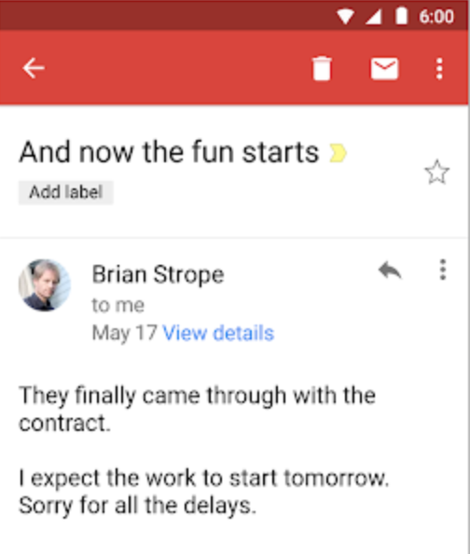
Incoming email
Replies returned
“Thanks”
“Sounds good”
“Thank you”
“No worries, thanks for the update!”
“Great news, thanks for the update.”
“That’s great news!”
Taking frequency into consideration

Slide 21
Outline
Model design
Incorporating hierarchical structures
Engineering challenges
Safe but too generic replies
Replies with repetitive patterns
On-Device Deployment
Extended to other application scenarios

Slide 22
Replies with repetitive patterns
Three semantically-similar responses are returned.
Example: reply triplets like “How about tomorrow?” & “Wanna get together tomorrow?” & “I suggest we meet tomorrow.”
More Diverse Recommendations are preferred by users.

Slide 23
Solution: modeling reply intent
A neural network model is employed to capture user intent of a potential response:
How about tomorrow?
intent
Convey the same intent!
Wanna get together tomorrow?
intent

Slide 24


Solution: favoring diverse intents
How about tomorrow?
Wanna get together tomorrow?
I suggest we meet tomorrow
What time will work for you?
Can you please let me know your preferred time?
Well, maybe not.

Slide 25
Outline
Model design
Incorporating hierarchical structures
Engineering challenges
Safe but too generic replies
Replies with repetitive patterns
On-Device Deployment
Extended to other application scenarios

Slide 26

On-Device Deployment: Privacy Concerns
Private user data
to
Data center
Federated Learning

Slide 27
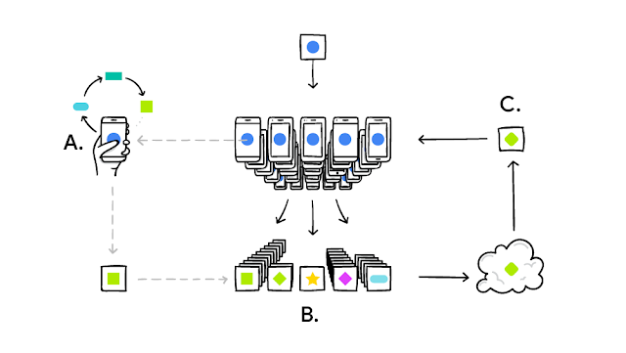
On-Device Deployment: Federated Learning
Your device downloads the current model from cloud
Improves it by learning from data on your phone
Then summarizes the changes as a small focused update
This update to the model is sent to the cloud
It is immediately averaged with other user updates to improve the shared model

Slide 28
Issues with the standard model
Number of model parameters is too large;
The computation resources needed is too high;
The storage requirement of all potential responses is high.

Slide 29
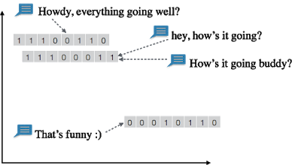
Solution: Embed both the email and potential response into binary vectors
Response similarity can be measured by calculating their Hamming distance
Number of bits that are different between two binary vectors

Slide 30
Solution: Embed both the email and potential response into binary vectors
Advantages:
Smaller memory footprint
Faster retrieval speed

Slide 31
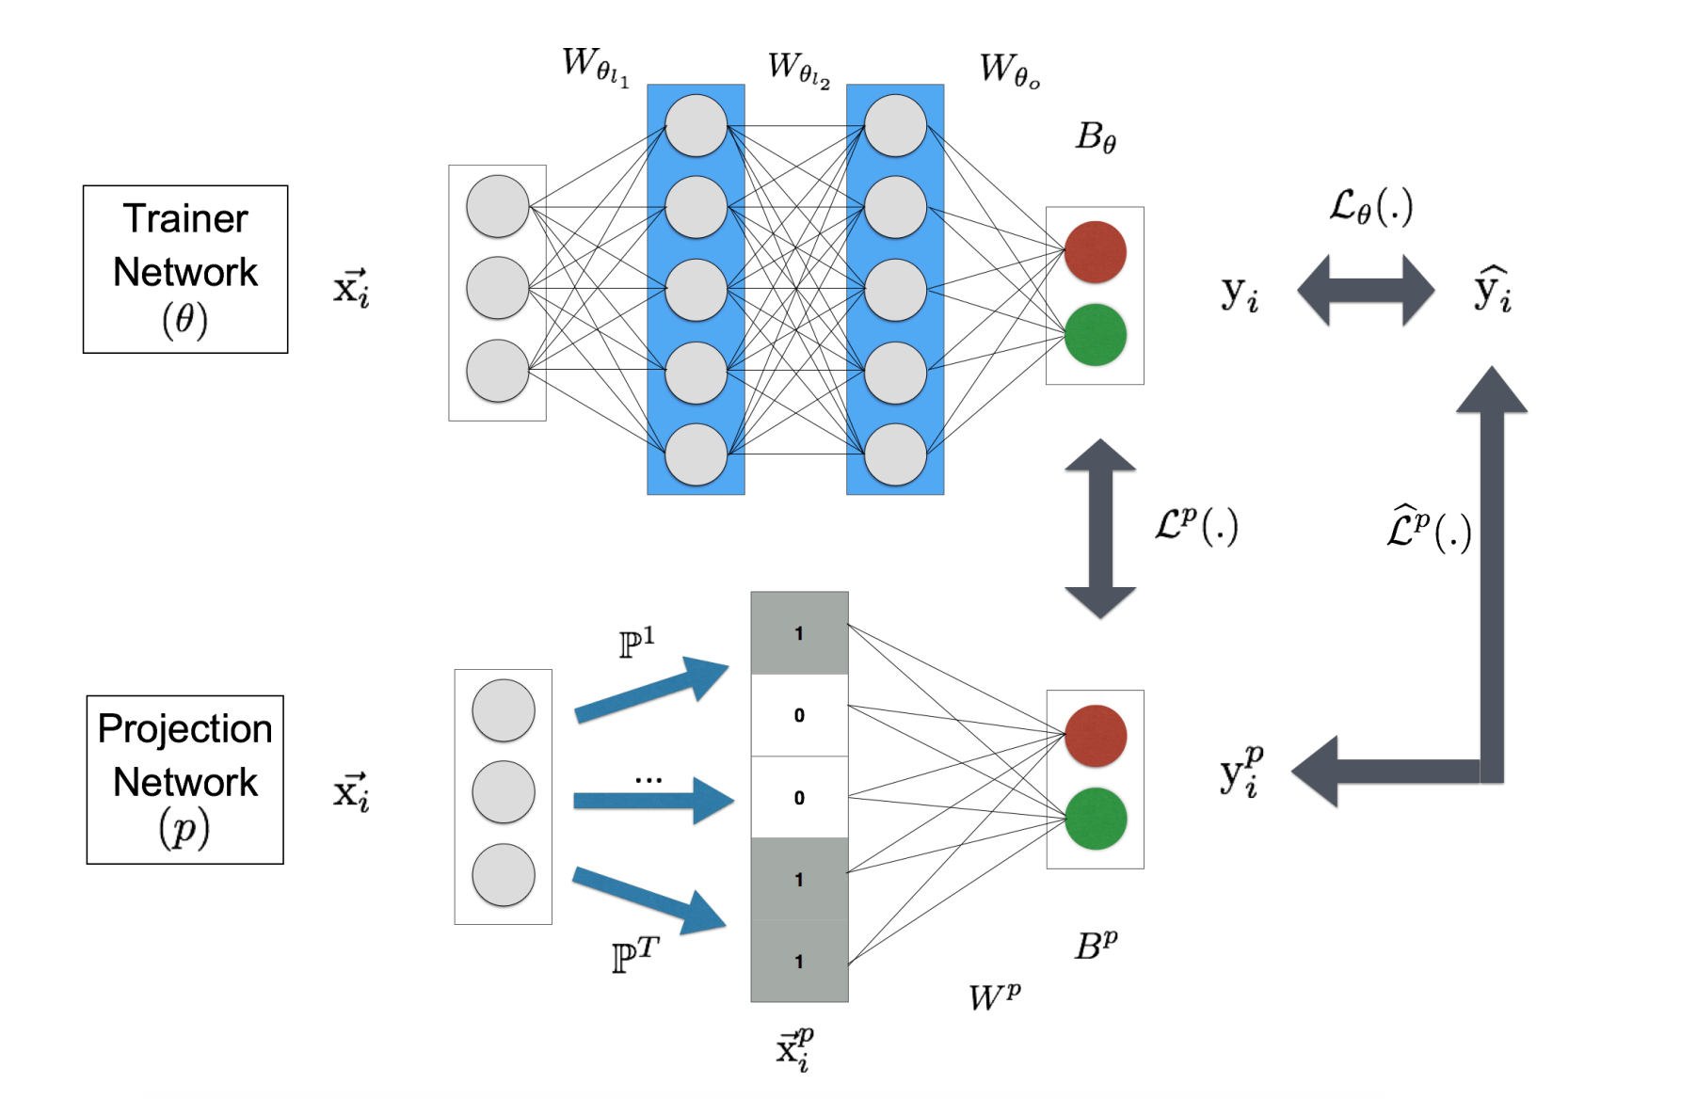
Semantic Hashing: real-valued to binary representations
Real-valued Embedding
Jointly learning!
Binary Embedding

Slide 32
Solution: Embed both the email and potential response to binary vectors
Hamming distance: 1
Binary embeddings of potential replies are efficiently stored
Incoming email is quickly transformed into a binary vector with the projection networks
The matching between email embedding and potential replies are efficiently carried out
1001110001
1011110001
Projection Networks
Incoming email
Reply

Slide 33
Outline
Model design
Incorporating hierarchical structures
Engineering challenges
Safe but too generic replies
Replies with repetitive patterns
On-Device Deployment
Extended to other application scenarios

Slide 34
Extension to G Suite

Slide 35
Extension to G Suite
Richer contextual information
Other data types
Modeling user identity

Slide 36
Smart Compose
Context => Responses
Only common strings will be returned
Compressing LSTM models

Slide 37
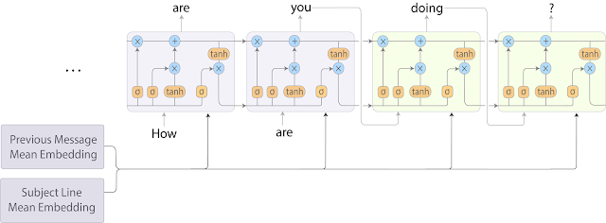
Smart Compose RNN-LM model architecture
Encode the subject and previous email by averaging the word embeddings in each field
Join those averaged embeddings, and feed them to the target sequence RNN-LM at every decoding step

Slide 38
Smart Compose RNN-LM model architecture
Accelerated Model Training & Serving: TPU
(Smart Compose running on a standard CPU had an average serving latency of hundreds of milliseconds, which is still unacceptable for a feature that is trying to save users' time)
Fairness: no human bias is injected into the model
(Semantics derived automatically from language corpora contain human-like biases)

Slide 39
Thanks for your attention!

